Slide 1
Sneak Peek
Let’s communicate online!

Slide 2
Kassy LaBorie

Slide 3
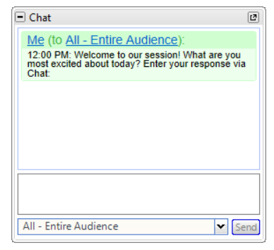
Communicate using Chat
Send both public & private messages:
Public:
Private: Choose from the drop down

Slide 4
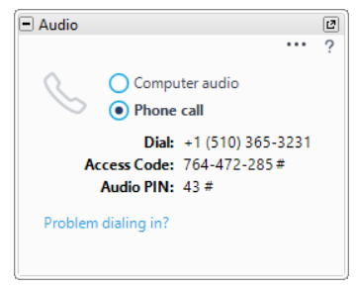
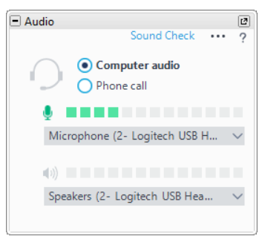
Communicate via Audio
Phone call
Your account’s information
Computer audio
Pay Attention!
Unmuted Muted

Slide 5
Communicate by giving Feedback
Raising your hand
Responding to poll questions

Slide 6
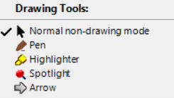
Let’s learn about you!
Communicate using
Drawing Tools

Slide 7
You’ve got this!

